Slide 1




NEXT GEN EMPLOYABILITY PROGRAM
Creating a future-ready workforce
College Name
Student Name : Jade Sampaguita Lee
Student ID : au311121205024
LOYOLA – ICAM COLLEGE OF ENGINEERING AND TECHNOLOGY

Slide 2

CAPSTONE PROJECT SHOWCASE
Project Title
Music Web Application using Django Framework
Abstract | Problem Statement | Project Overview | Proposed Solution | Technology Used | Modelling & Results | Conclusion

Slide 3
Abstract
This project aims to develop a music web application using the Django framework, integrating front-end technologies like HTML, CSS, JavaScript, and Bootstrap, with back-end technologies including Python, Django, and SQL. The absence of a centralized platform for music enthusiasts to explore, listen to, and manage their favorite tracks and albums motivates this endeavor. The proposed solution entails creating a user-friendly interface that seamlessly combines front-end and back-end functionalities, facilitating music discovery, playlist creation, and social interaction. By leveraging Django's robust capabilities for server-side logic and data management, alongside SQL databases for efficient data storage, retrieval, and manipulation, the project endeavors to deliver a responsive and feature-rich music platform accessible across various devices and browsers.
Source :

Slide 4
Problem Statement
In a world inundated with diverse musical content, there exists a notable gap in the availability of a centralized platform catering to music enthusiasts' needs for seamless exploration, organization, and interaction with their favorite tracks and albums. Current platforms often lack comprehensive features for discovering new music, creating personalized playlists, and engaging with fellow users. This deficiency highlights the need for a music web application that not only aggregates a vast library of music but also provides intuitive tools for users to curate their listening experiences and connect with like-minded individuals. The challenge lies in developing a robust solution that integrates front-end and back-end technologies effectively, ensuring a smooth user experience while addressing the complexities of data management and social interaction within the platform.
Source :

Slide 5
Project Overview
The main objectives of the project is the development of a music web application using Django.
The key features are user authentication, music browsing, playlist creation, and social interaction.
The responsive design and cross-browser compatibility to ensure accessibility across different devices and platforms is an important consideration.
Source :

Slide 6
Proposed Solution
.
Cadence is a music web app that encompasses scalable and user friendly stacks to deliver a seamless music rendering service.
The use of Django as the back-end framework is for handling server-side logic and data management.
The integration of front-end technologies such as HTML, CSS, JavaScript, and Bootstrap is to create a visually appealing and interactive user interface.
The implementation of SQL databases to store user data, music metadata, and playlist information helps ensure efficient data retrieval and manipulation.
Source :

Slide 7


Technology Used
Front-end
Back-end
Source :

Slide 8
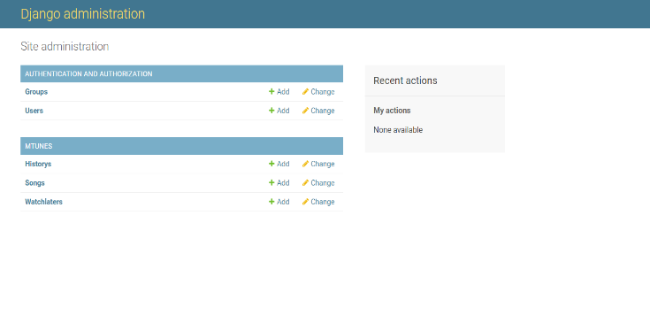
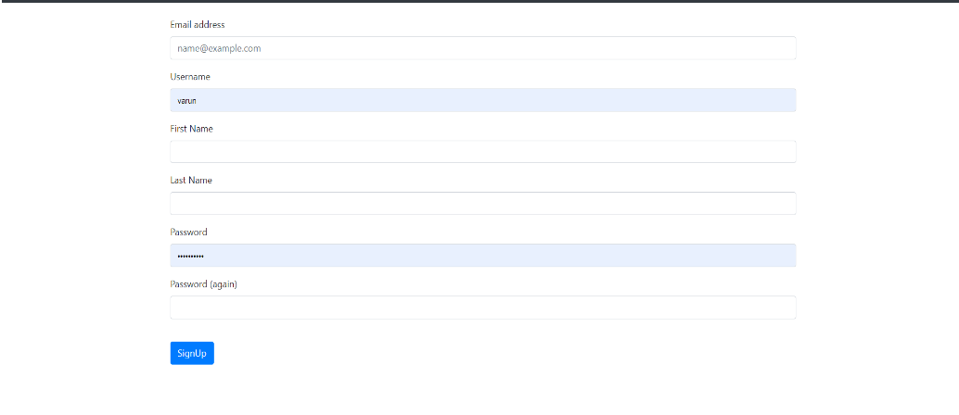
Modelling & Results
Source :

Slide 9
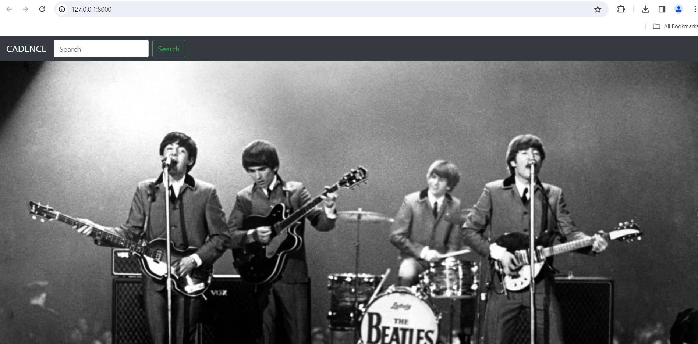
Homepage

Slide 10
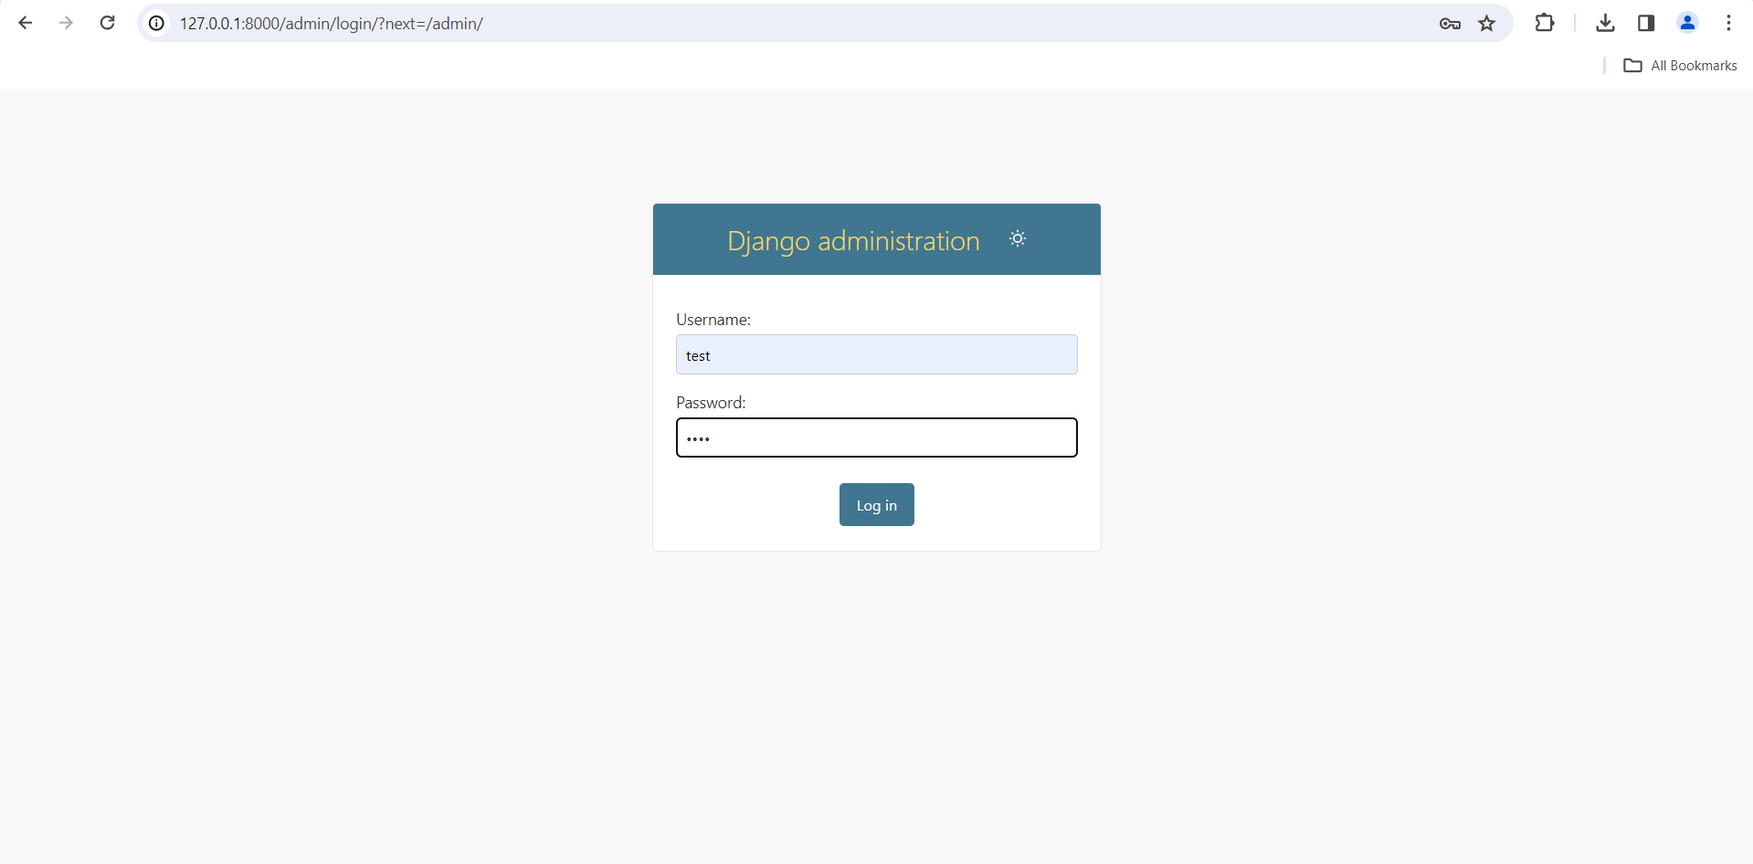
Login Page

Slide 11
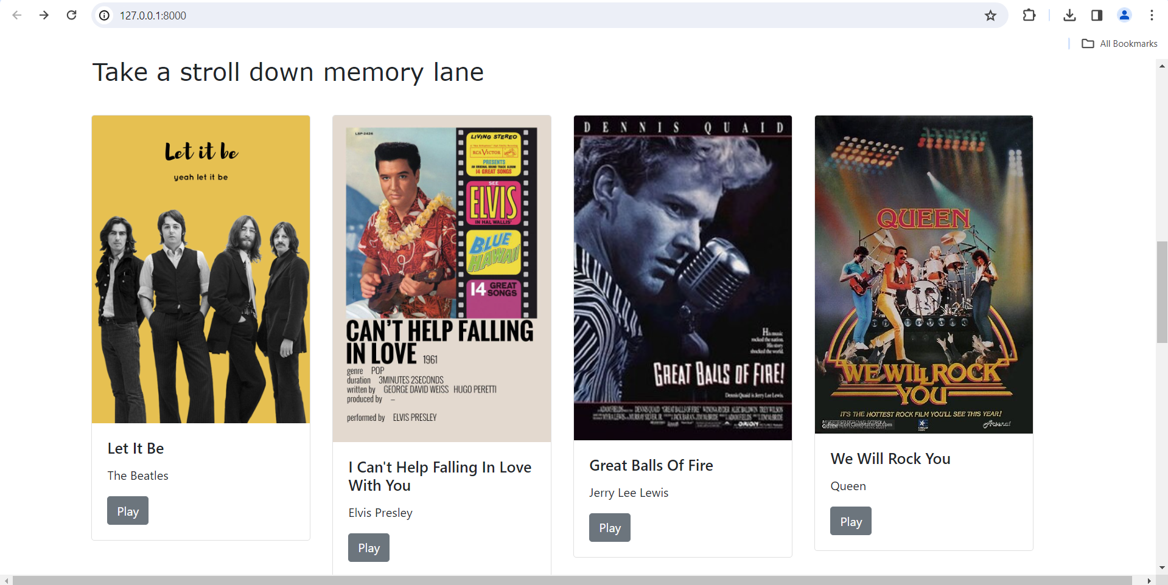
Song Collection Page

Slide 12
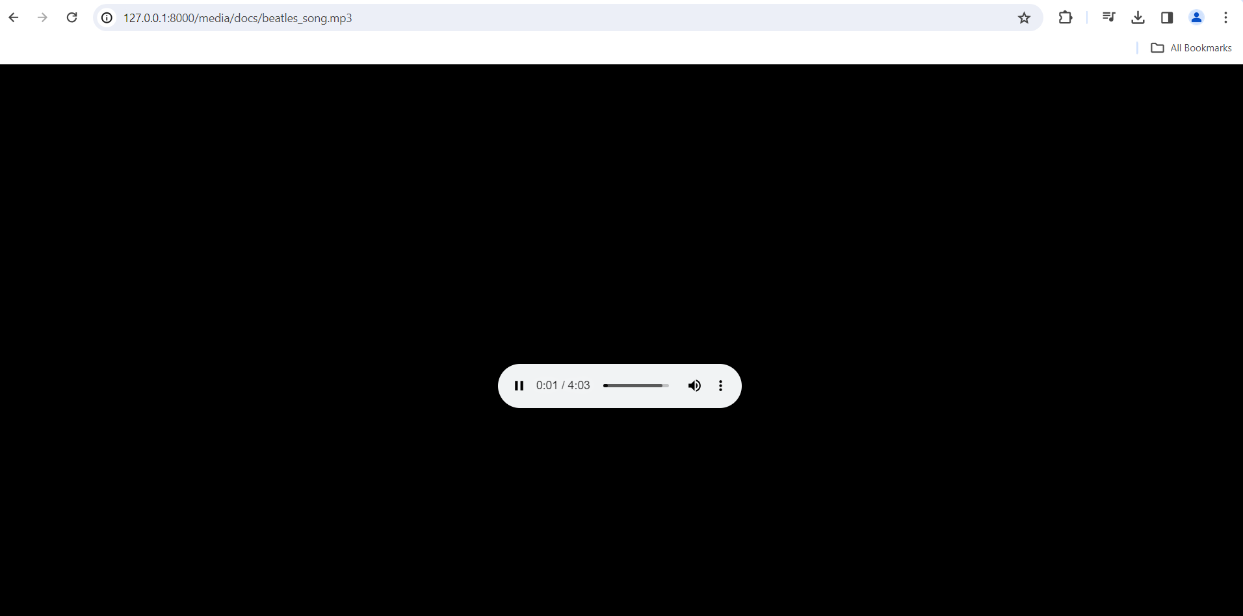
Song Page

Slide 13
Future Enhancements:
1. Personalized Recommendations: Enhance with machine learning for custom music suggestions.
2. Social Features: Introduce messaging, music sharing, and collaborative playlists.
3. API Integration: Include Spotify and Apple Music for a broader music selection.
4. Mobile Apps: Develop iOS and Android apps for mobile convenience.
5. Monetization Options: Explore premium subscriptions and ad-supported models for revenue.

Slide 14
Conclusion
The development of the music web application Cadence using Django and front-end technologies has provided a user-friendly platform for music enthusiasts. While achieving our primary goals, there are promising opportunities for future enhancements, including personalized recommendations, expanded social features, and mobile app development. With ongoing innovation, our application stands poised to become a leading destination for music discovery and enjoyment.
Source :

Slide 15
Thank You!
Notes:
Thank You !!

